Slide 1
Simple Harmonic Motion
Physics 211 Lab

Slide 2
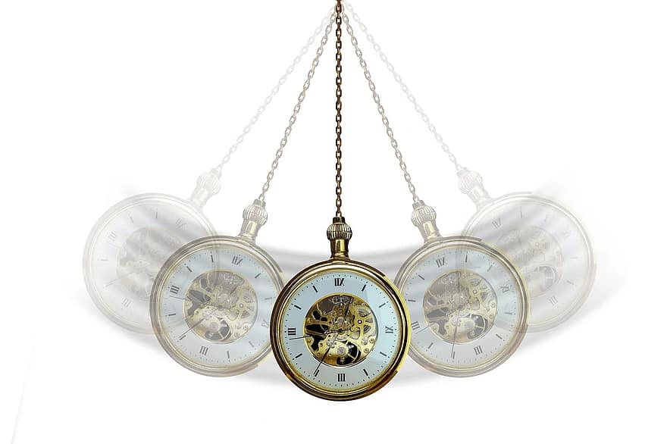

Slide 3


Slide 5
A 1kg mass block is attached to the end of spring suspended vertically from a ceiling support.
The spring has a spring constant, K=100N/m and a natural length of 1 m.
When the mass is attached, the spring elongates to 1.1m.
This is known as the equilibrium position.
1kg

Slide 6
The block is pulled down an additional 0.4m and then released.
Fill in the below table with the relevant information.
Position | Delta x | Fs (N) | Pes (J) | Peg (J) | V (m/s) | KE (J)
0 | 0.1 | 10 | 0.5(100)(0.1)^2 0.5J |  | 0 | 0
1 | 0.5 | 50 | 0.5(100)(.5^2) 12.5J | 0 | 0 | 0
2 | 0.1 | 10 | 0.5(100)(.1^2) 0.5J | 4 Mgh=1(10)(.4) | 4 | 8 0.5(1)v^2
3 | (-)0.3 | 50 | 0.5(100)(.3^2) 4.5 | 8 | 0 | 0
4 | 0.1 | 10 | 0.5J | 4 | -4 | 8
5 | 0.5 | 50 | 12.5J | 0 | 0 | 0
6 | 0.1 | 10 | 0.5(100)(.1^2) 0.5J | 4 | 4 | 8

Slide 8
Angular Frequency, Omega
Omega=sqrt(k/m)
Omega= 10
Frequency, F
F=1/(2pi)*omega
F=1.6 (sec^-1)
Period, T
T=1/F=0.625 sec

Slide 9
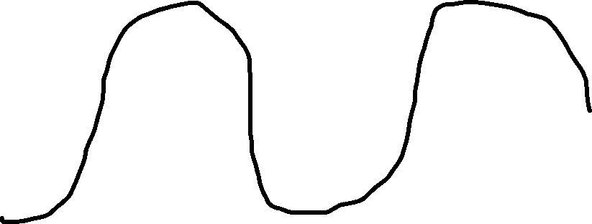


.6255
sec

Slide 10
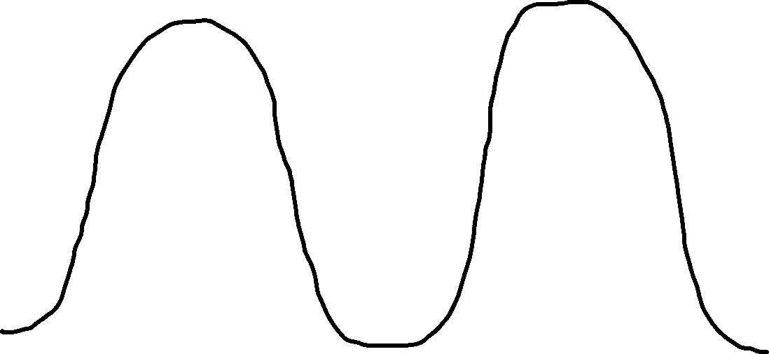

Slide 11
A 1kg mass block is attached to the end of spring suspended vertically from a ceiling support.
The spring has a spring constant, K=80Nm and a natural length of 1 m.
When the mass is attached, the spring elongates to 1.1m.
This is known as the equilibrium position.
1kg

Slide 12
The block is pulled down an additional 0.6m and then released.
Fill in the table with the relevant information
Position | Delta x | Fs (N) | Pes (J) | Peg (J) | V (m/s) | KE (J)

Slide 13
Angular Frequency, Omega
Omega=sqrt(k/m)
Omega=
Frequency, F
F=1/(2pi)*Omega
F=
Period, T
T=1/F=

Slide 14

